Slide 1
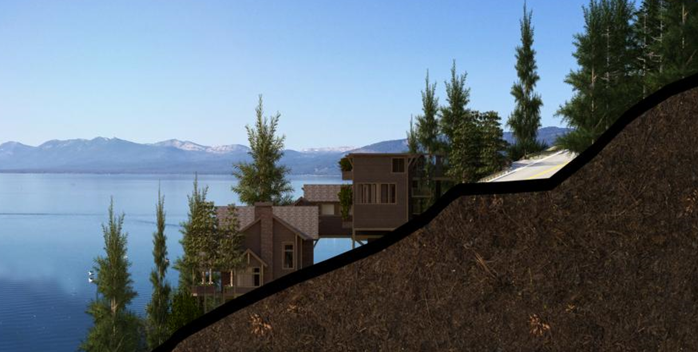
WSUP20-0020 447 Lakeshore Grading
Washoe County Board of Adjustment
December 3, 2020

Slide 2
Request
Request for a driveway to traverse a slope of thirty (30) percent or greater.
Request to construct a permanent earthen structure greater than 4.5 feet in height within the required front yard setback.
Requesting to vary standards found in WCC Section 110.438.45 (a) to allow slopes in excess of, or steeper than, three horizontal to one vertical (3:1) and WCC Section 110.438.45 (d) to allow retaining walls taller than and one-half (4.5) feet within the front yard setback.

Slide 3
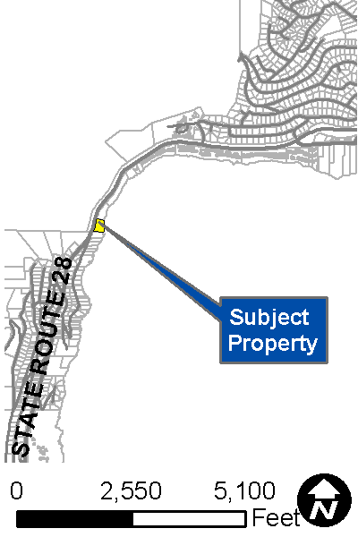
Vicinity Map
Located off of State Route 28
NDOT requires the use of only legal permitted accesses on its State roadways. All driveway accesses and other improvements to the state highway system will be required to comply with the NDOT Access Management System and Standards, and Terms and Conditions Relating to Occupancy Permits current at the time of application.
NDOT standards generally allow direct access to state routes when there are no other means of alternate access available.

Slide 4
Major Grading Thresholds
WCC 110.438.35 (3) Any driveway or road that traverses any slope of thirty (30) percent or greater (steeper).
WCC 110.438.35 (4) Grading to construct a permanent earthen structure greater than four and one-half (4.5) feet within the required front yard setback.

Slide 5
Grading
The proposed grading area is 19,713 square feet
Cut - 150 cubic yards
Fill - 316 cubic

Slide 6
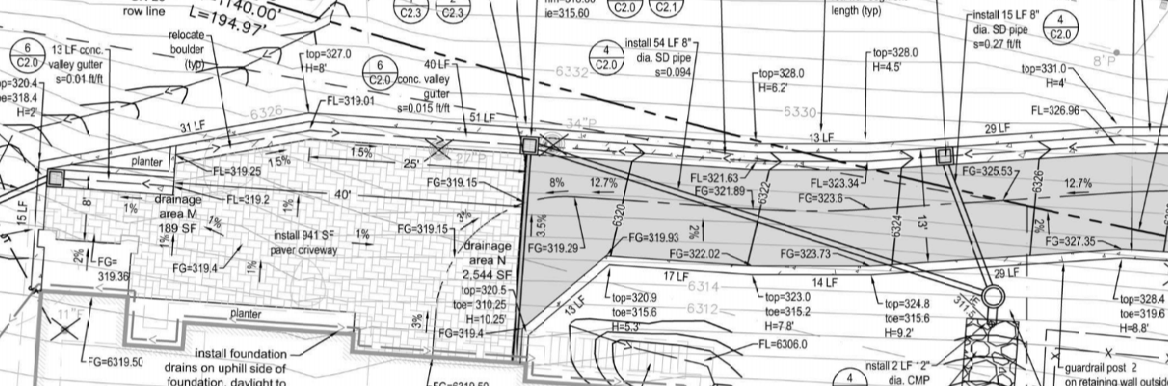
Driveway
Along the eastern wall (blue) the proposed heights of the retaining wall range from 5 feet 3 inches, to the tallest point of 10 feet 2 inches. This eastern wall is important for supporting the proposed driveway.
Along the western wall (purple) the proposed heights of the retaining walls are range from 2 feet to 10 feet.
The red line indicates the property line.

Slide 7
Background
The site is undeveloped with trees and native vegetation
The site is constrained with steep slopes.
With the approval of the Special Use Permit, the site will eventually be developed with a garage and large single-family residence.

Slide 8
Request to Vary Standards
WCC Section 110.438.45 (d), Within the front yard setback area of a parcel with a residential use or zoned for residential use, retaining walls are limited to a maximum of four and one-half (4.5) feet.
WCC Section 110.438.45 (a), Grading shall not result in slopes in excess of, or steeper than, three horizontal to one vertical (3:1).

Slide 9
Request to Vary Standards
Due to the topography of the site, staff is in support of the two requested modifications.
Without these modifications the site would be undevelopable.

Slide 10
Public Notice & CAB
Public notice was sent to 51 parcels
The Incline Village CAB reviewed the application on November 2, 2020 and recommended to approve the project 4-1
Discussion included indemnification for the County if fire engines were damage, retaining wall height, and building wall height.

Slide 11
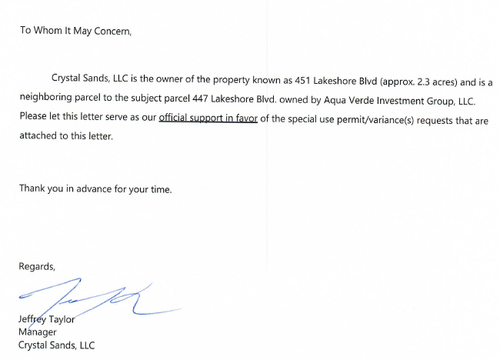
Public Letter in Support
Letter was received by Mr. Taylor on November 2, 2020.

Slide 12
Special Us Permit Findings
1. Consistency;
2. Improvements;
3. Site Suitability; and
4. Issuance Not Detrimental
Staff is able to make all the required findings, as detailed in the staff report

Slide 13
Possible Motion
I move that, after giving reasoned consideration to the information contained in the staff report and information received during the public hearing, the Washoe County Board of Adjustment approve with conditions Special Use Permit Case Number WSUP20-0020 for Aqua Verde Investment Group, LLC, having made all five findings in accordance with Washoe County Code Section 110.810.30

